Slide 1

Basic Details of the Team and Problem Statement
Ministry/Organization Name/Student Innovation: Ministry of education
PS Code: SIH1434
Problem Statement Title: Making career choices and AI based counselling accessible to every child at secondary level along with aptitude tests and detailed career paths.
Team Name: MyVision
Team Leader Name: Harsh Choudhary
Institute Code (AISHE): U-0890
Institute Name: Bennett University
Theme Name: Smart Education

Slide 2
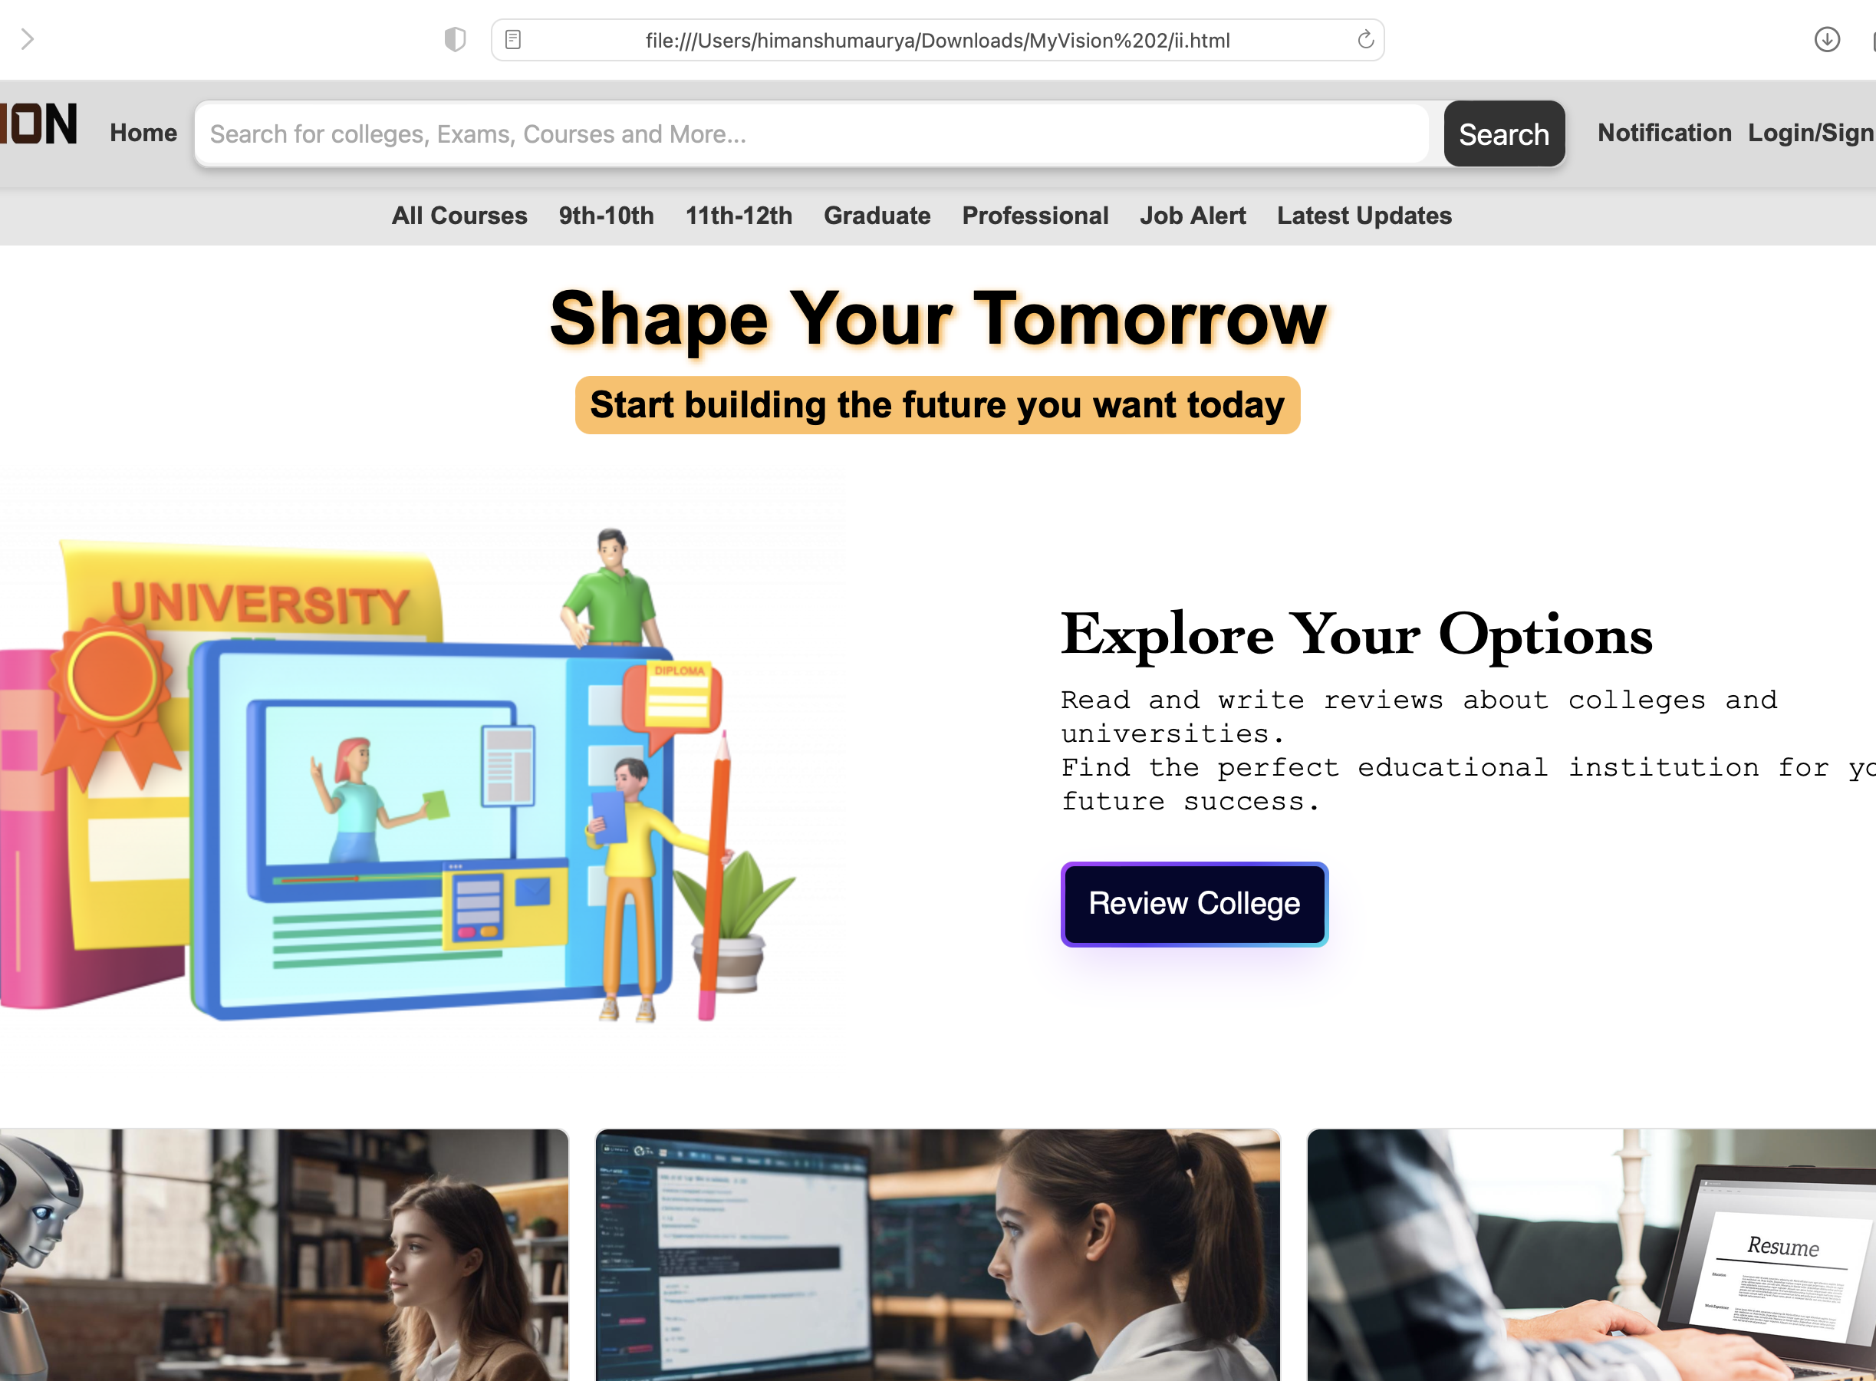
Idea/Approach Details
Describe your idea/Solution/Prototype here:
Our project provides holistic student guidance with AI counselling, aptitude tests, and personalized career paths.
Our goal is to provide career counselling for all secondary level students, especially in underserved communities, closing the career guidance gap.
Our platform uses smart technology to give students personalized career advice based on their goals and abilities.
We will include career recommendations for different educational levels (9th-10th, 11th-12th, Graduate), job alerts, and the latest updates.
Describe your Technology stack here:
We use machine learning libraries like SVM Decision Tree XG Boost for AI-based counseling.
Web development technologies like HTML, CSS and javascript are employed to create a user-friendly interface.

Slide 3
Idea/Approach Details
Describe your Use Cases here
Career Exploration: Students can use our platform to explore a wide range of career options, aided by detailed information and real-world insights, helping them make informed choices.
Aptitude Assessment: Our aptitude tests evaluate individual strengths and areas for improvement, providing valuable insights into suitable career paths.
Personalized Counselling: AI-driven counselling offers personalized advice and recommendations based on a student's aptitude and interests, enhancing their career decision-making process.
Accessibility: Our project ensures that every secondary-level student, regardless of their background, has access to essential career guidance, reducing disparities in educational and career opportunities.
Describe your Dependencies / Show stopper here
Data Availability: Access to accurate and up-to-date career data, including job market trends and educational requirements, is essential for meaningful guidance.
AI Model Performance: The effectiveness of our AI counselling heavily depends on the accuracy and performance of our machine learning models.
Scalable Infrastructure: A robust and scalable IT infrastructure is necessary to handle a potentially large user base without downtime or performance issues.
User Engagement: Ensuring students actively engage with the platform and follow through with career decisions is vital for the project's long-term impact.
Regulatory Compliance: Compliance with data privacy and educational regulations is crucial to avoid legal obstacles.

Slide 4
Team Member Details
Team Leader Name: Harsh Choudhary
Branch Btech Stream CSE Year III
Team Member 1 Name: Harshit Singh
Branch Btech Stream CSE Year III
Team Member 2 Name: Ishaan Asthana
Branch Btech Stream CSE Year III
Team Member 3 Name: Kavya Thakur
Branch Btech Stream CSE Year III
Team Member 4 Name: Himanshu Maurya
Branch Btech Stream CSE Year III
Team Member 5 Name: Sparsh Aryan
Branch Btech Stream CSE Year III

